Slide 1
GEANT4 simulation for investigation of the radiation effects on composite silicate compounds.
Hovsepyan G., Harutyunyan V., Aleksanyan E., Badalyan A., Barseghyan N.
Yerevan Physics Institute.
Neutron Physics and Radiation Materials 27-30 Oct. 2025 Yerevan
Hovsepyan G

Slide 2

GEANT4 simulation we used as additional method for examine the irradiation tolerance of silicate-based compounds synthesized via a hydrothermal microwave-assisted method.
The effects of proton irradiation on zinc silicates (Zn2SiO4) and cerium-doped zinc silicates, exposing them to 15.5 MeV proton beams at fluences ranging from 10¹³ to 10¹⁵ prot./cm² and electrons 10¹⁷ elec./cm² with energy 20MeV was investigated via GEANT4 simulation.
Neutron Physics and Radiation Materials 27-30 Oct. 2025 Yerevan
Hovsepyan G

Slide 3
Proton irradiation experiments were performed at the Radioisotope Production Center, Yerevan, Armenia, utilizing the C-18 cyclotron facility.
The proton beam was delivered with a beam current of approximately 0.6 μA, corresponding to a flux density on the order of 10¹² protons·cm⁻²·s⁻¹.
In reality, the accelerator produces a proton beam corresponding to 18 MeV, but only 15.5 reach the target.
The simulation is as close as possible to the actual experimental situation.
Neutron Physics and Radiation Materials 27-30 Oct. 2025 Yerevan
Hovsepyan G

Slide 4
In the "main" program, RunManager is initialized and the user programs are launched: a) DetectorConstruction – a user-defined description of the setup's dimensions, materials used, etc. The setup is housed in a 20x20x31 cm³ mother volume (World) filled with atmosphere. b) PhysicsList – a user-defined list of physical processes included in the simulation. c) ActionInitialization – launches user-defined tasks:
Neutron Physics and Radiation Materials 27-30 Oct. 2025 Yerevan
Hovsepyan G

Slide 5
For our task, a list of physical processes was selected that includes elastic and inelastic scattering of ions and hadrons, photonuclear processes, decay, radiation effects, as well as electromagnetic processes included in G4EmStandardPhysicsWVI
The configuration described in DetectorConstruction is as follows:
1) The vacuum system of a proton accelerator producing a particle beam with an energy of 18 MeV is isolated from the atmosphere by a 100 µm thick stainless steel plate.
2) The target is, in one case, pure willemite (Zn2SiO4) with a density of ρ = 3.69 g/cm3, and in the other, a crystal doped with 3% cerium oxide (97% Zn2SiO4 + 3% Ce2O3). In both cases, they are installed 30 cm from the accelerator exit and have the same dimensions: 1.0 mm thick and 2 x 2 cm² in area.
3) Particles scattered in the metal plate and atmosphere are separated from the beam by an aluminum collimator with a window area of ​​approximately 2 cm² and a thickness of 4 mm, located 5 cm from the target.
4) The primary particle beam (protons and electrons) is directed along the Z-axis in the coordinate system adopted in GEANT4.
5) The energy of the primary protons is 18 MeV, and for the electrons is 20 MeV. For all cases, the number of generated particles (protons and electrons) is N0 = 2 x 10⁵.
Neutron Physics and Radiation Materials 27-30 Oct. 2025 Yerevan
Hovsepyan G

Slide 6
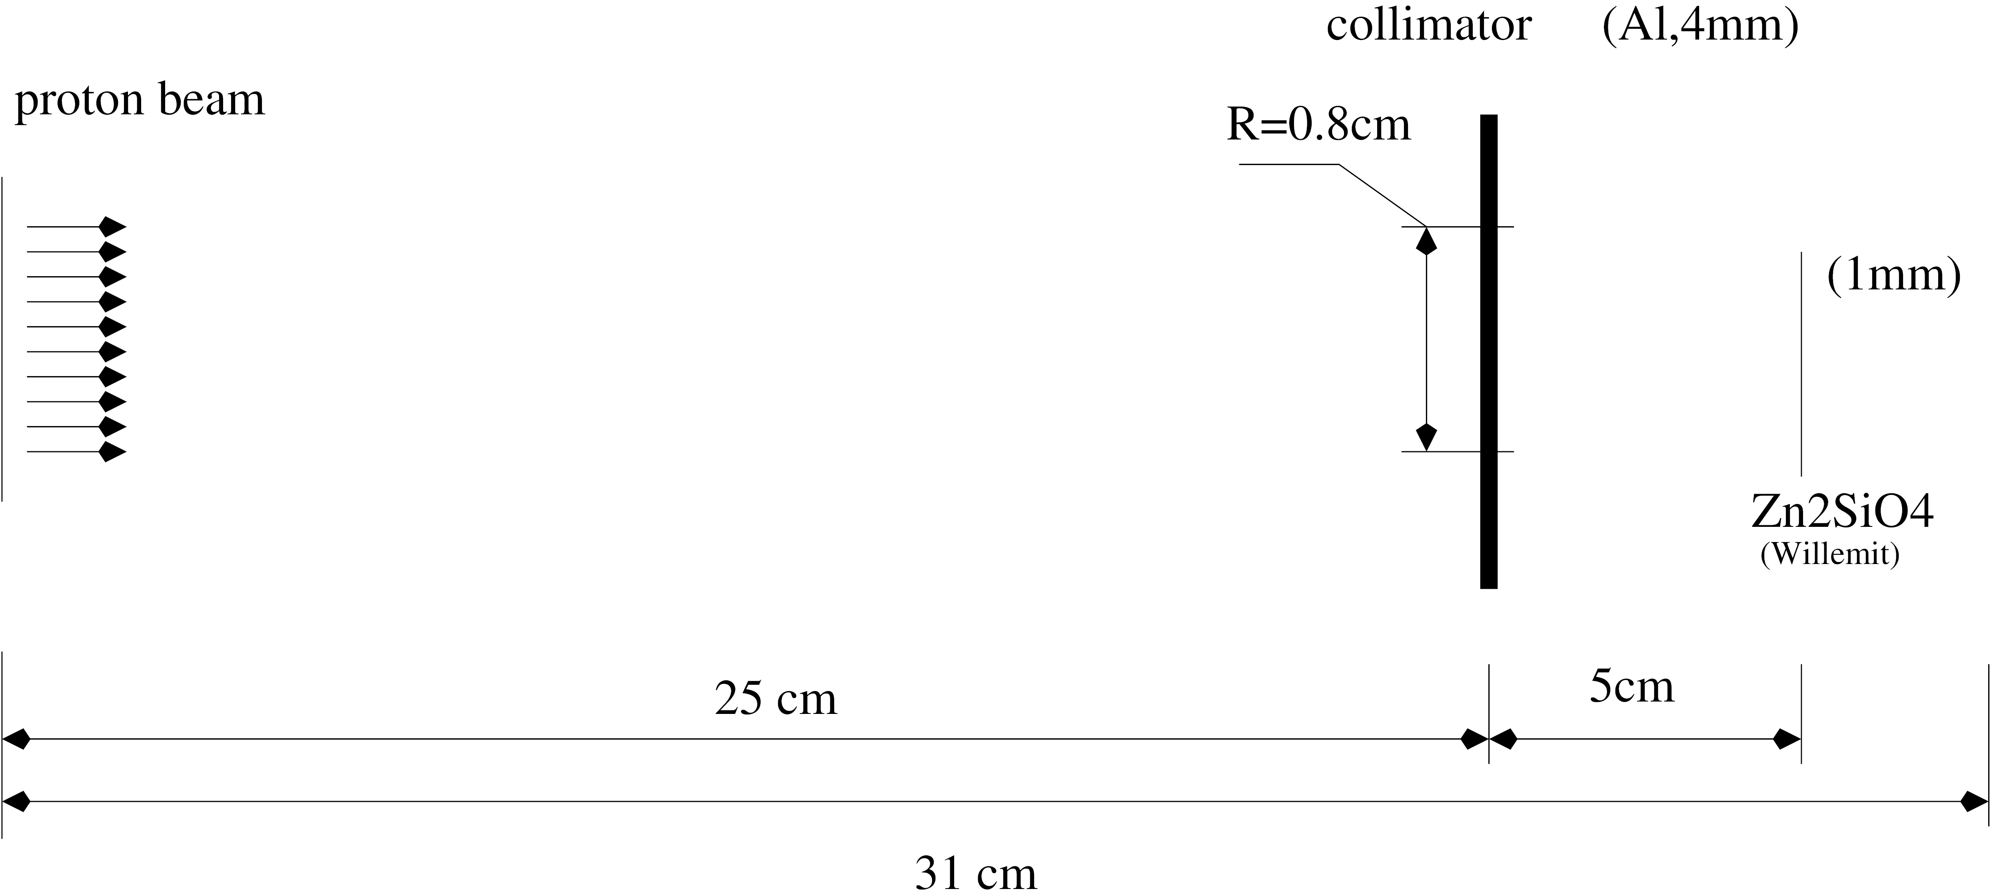
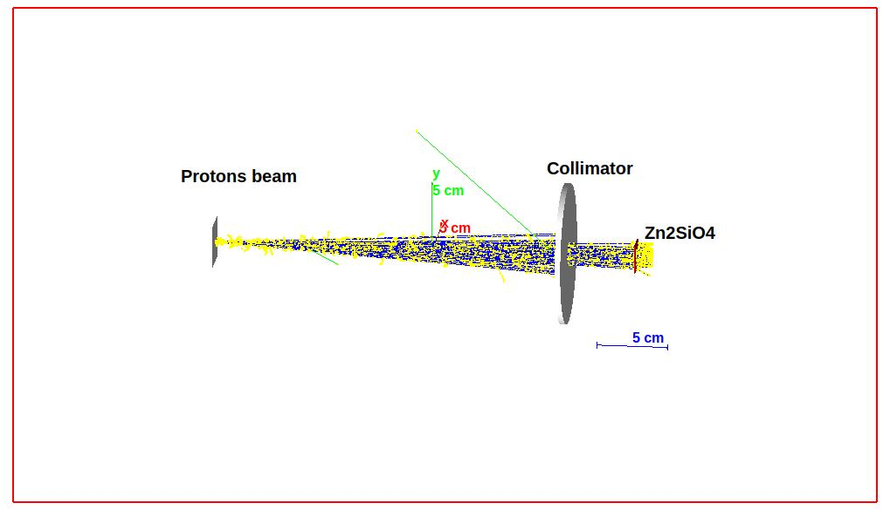
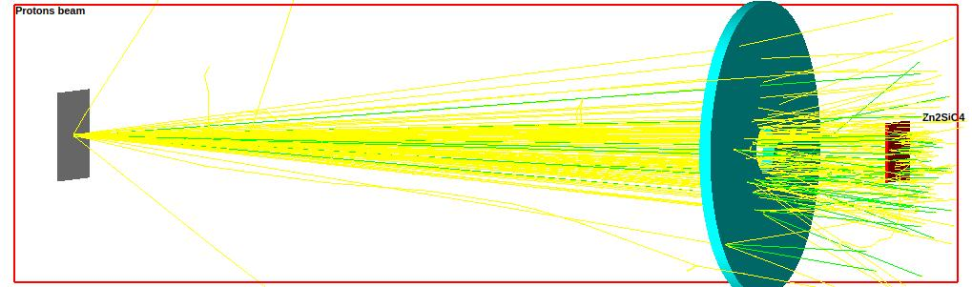
Protons - blue
Electrons – yellow
Positrons - green
Ions - red
Due to scattering of the beam in the atmosphere, out of the total number of particles No = 2 x 10⁵, the collimator transmitted about 50% of protons and ~35% of electrons.
Neutron Physics and Radiation Materials 27-30 Oct. 2025 Yerevan
Hovsepyan G

Slide 7
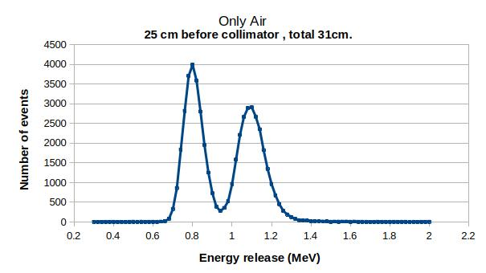
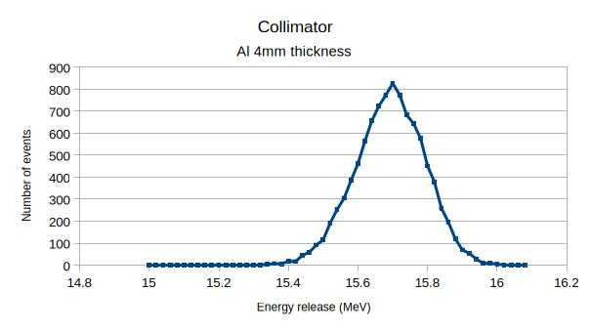
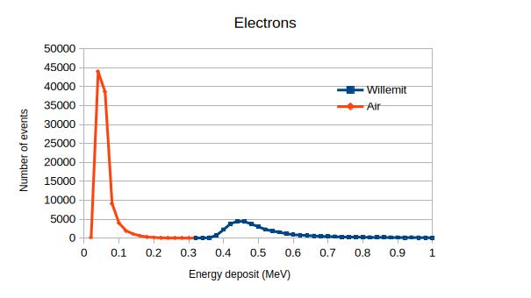
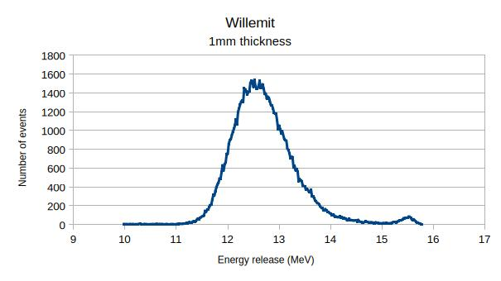
Energy release in Air, Collimator and Zn2SiO4
The first peak (0.8 MeV) corresponds to the energy loss of protons within 25 cm of the atmosphere, which hit the collimator body and were absorbed there. The second peak, 1.1 MeV, corresponds to protons that traveled the entire 31 cm of the atmosphere.
The distribution mode is equal to 15.72 MeV, and taking into account the losses in 25 cm of the atmosphere, we practically observe the proton energy – E0 = 16.5 MeV at the exit from the accelerator vacuum system, after 100 μm of foil.
The average loss is 12.7 MeV. A characteristic peak of total proton absorption in the target is observed at 15.5 MeV. Their amount does not exceed 1.3% of the flux hitting the target.
For an electron beam, approximately 38% reaches the target due to scattering. Electrons with energies of ~20 MeV are considered relativistic, and their losses are in the region of the minimum of the ionization curve. Average ionization losses in the atmosphere are ~50 keV, and in the target, ~500 keV.
Neutron Physics and Radiation Materials 27-30 Oct. 2025 Yerevan
Hovsepyan G

Slide 8
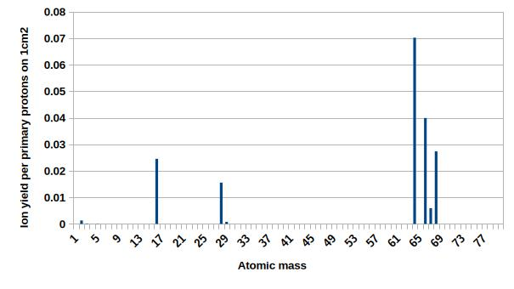
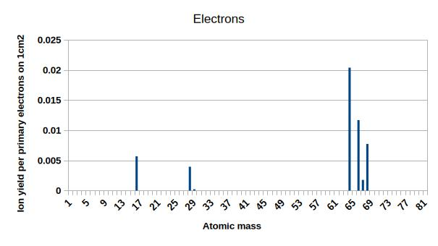
 | Protons |  | Electrons
Atom/Weight | At EK >1eV | At EK≥50eV | At EK≥1eV | At EK≥50eV
O 16 | 3.58E-02 | 1.11E-02 | 5.72E-03 | 2.17E-03
Si 28 | 2.39E-02 | 6.77E-03 | 4.09E-03 | 1.51E-03
Si 29 | 1.18E-03 | 3.26E-04 | 1.81E-04 | 4.61E-05
Zn 64 | 8.38E-02 | 2.87E-02 | 1.58E-02 | 6.89E-03
66 | 4.62E-02 | 1.55E-02 | 8.89E-03 | 3.86E-03
67 | 6.93E-03 | 2.19E-03 | 1.31E-03 | 5.69E-04
68 | 3.10E-02 | 1.08E-02 | 6.18E-03 | 2.70E-03
Ce 140 | 8.25E-03 | 3.73E-03 | 1.93E-03 | 9.80E-04
Summ. | 2.37E-01 | 7.91E-02 | 4.41E-02 | 1.87E-02
If, when simulating the passage of particles through a sample, we observe the zeroing of the kinetic energy of these atoms within the sample, this will indicate the formation of a Frenkel defect. The table shows the ion yield probabilities at threshold values ​​of Ed ≥ 1 eV and Ed ≥ 50 eV for Zn2SiO4 targets doped with 3% cerium oxide for proton and electron.
Neutron Physics and Radiation Materials 27-30 Oct. 2025 Yerevan Hovsepyan G

Slide 9
Energy distribution of knocked out atoms.
The occurrence of radiation defects is associated with the formation of an empty lattice site with the displacement of atoms into interstitial spaces. It is assumed that an atom must be imparted with energy above the threshold Ed to form such a defect (the Frenkel effect). A probable value for Ed is considered to be 25 eV for crystals with a binding energy of approximately 10 eV.
Theoretical consideration of the processes by which Frenkel defects arise under the action of charged particles predicts a power-law energy spectrum for atoms that have acquired excess kinetic energy. The energy spectrum of atoms, up to the approximations adopted in [Tamm I. E., Frenkel Ya. I. Usp. Phys. Nauk. 1962], is equal to:
where is the number of atoms of type A with kinetic energy in the interval , Const is a value that includes the maximum energy transferred to atom A (possible in a head-on collision), the Rutherford cross section, etc.
Neutron Physics and Radiation Materials 27-30 Oct. 2025 Yerevan
Hovsepyan G

Slide 10
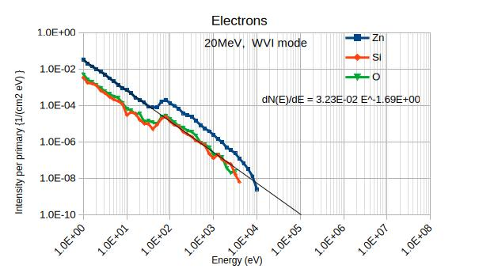
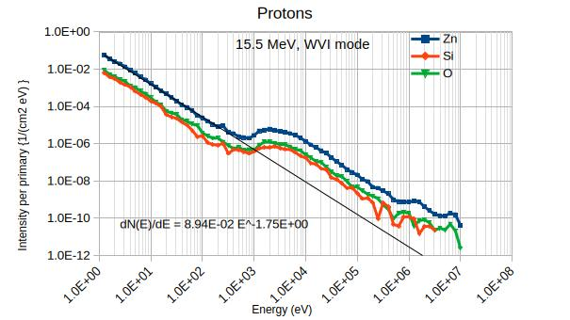
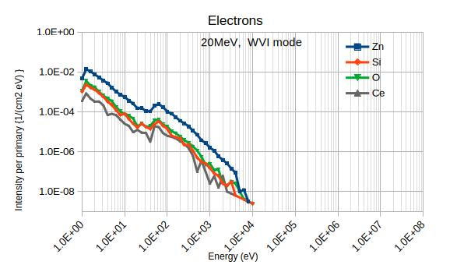
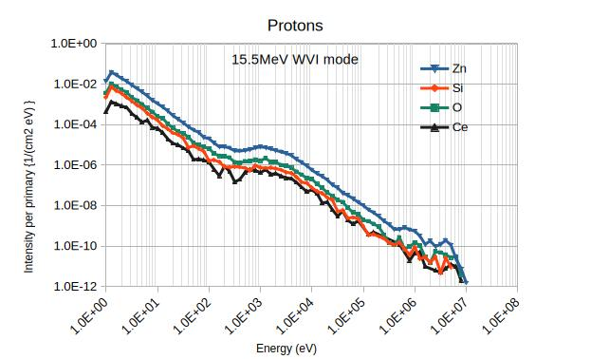
The intensity of atoms with E is
where dNi is the number of events in i-th bin of energy interval (dEi ), Ntot is the total number of protons hitting the target surface S .
Neutron Physics and Radiation Materials 27-30 Oct. 2025 Yerevan
Hovsepyan G

Slide 11
The intensity of atoms with E is
where dNi is the number of events in i-th bin of energy interval (dEi ), Ntot is the total number of protons hitting the target surface S .
Neutron Physics and Radiation Materials 27-30 Oct. 2025 Yerevan
Hovsepyan G

Slide 12
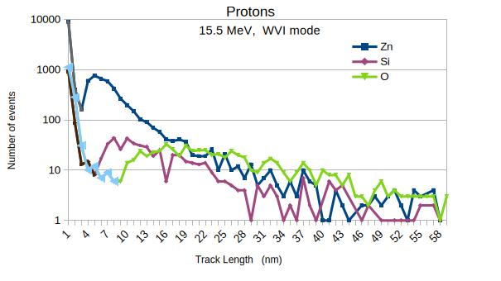
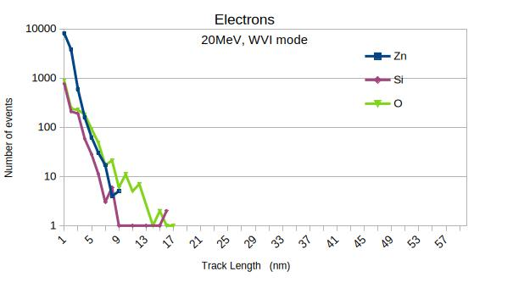
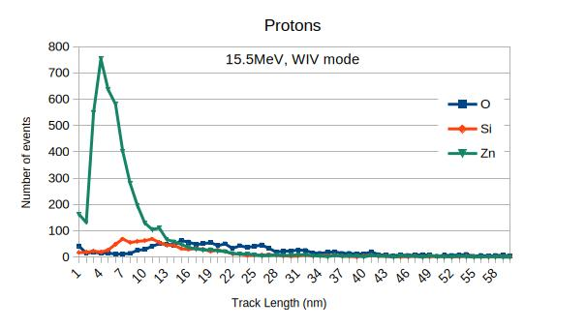
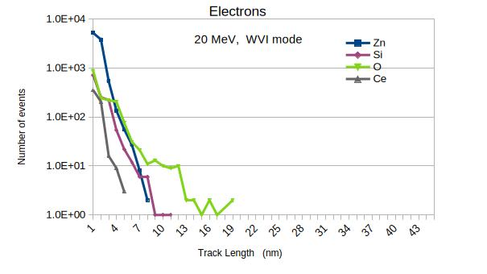
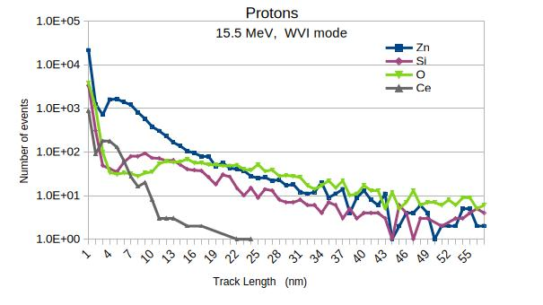
At small ranges of the track length, the shape of the curve for electrons and protons is identical (this is clearly visible for Si and O), after which a peak in the ranges is observed. For Zn - 5 nm, Si - 10 nm, and for O - about 20 nm. Here, a dependence on the atomic weights of these elements is clearly visible.
Neutron Physics and Radiation Materials 27-30 Oct. 2025 Yerevan
Hovsepyan G

Slide 13
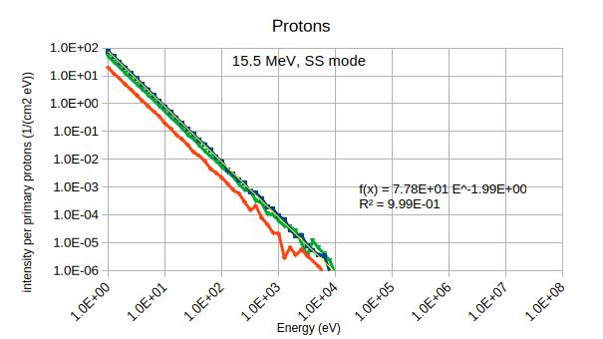
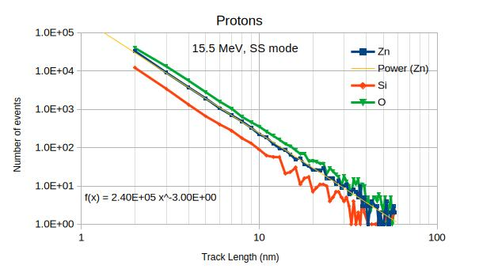
Neutron Physics and Radiation Materials 27-30 Oct. 2025 Yerevan
Hovsepyan G

Slide 14
Simulations showed that,
when one electron hits a 1 mm thick target surface, with probability ~0.04 ions with energies greater than 1 eV and ~0.02 ions with energies greater than 50 eV are formed.
for protons, ~0.237 ions with energies greater than 1 eV and ~0.08 ions with energies greater than 50 eV are formed.
Thus, at a fluence of 10¹⁵ prot/cm², a total of more than 6.46*10¹³ Frenkel defects are formed in the target. For an electron fluence of 10¹⁷ e-/cm2, the Frenkel defects will be approximately 2.*10¹⁵ .
The probable ranges for the path of ions with energies ≥50 eV were approximately 20 nm, 11 nm, and 5 nm for O, Si, and Zn, respectively. For Ce, this value was approximately 1 nm.
The energy spectra of ejected ions exhibit a characteristic peak when irradiated with protons in the keV energy range, and when irradiated with electrons in the 100 eV region. Modeling suggests that these peaks are formed due to multiple scattering in the target.
Neutron Physics and Radiation Materials 27-30 Oct. 2025 Yerevan
Hovsepyan G

Slide 15
Thank You !
Neutron Physics and Radiation Materials 27-30 Oct. 2025 Yerevan
Hovsepyan G

Slide 16
Neutron Physics and Radiation Materials 27-30 Oct. 2025 Yerevan
Hovsepyan G

